Slide 1
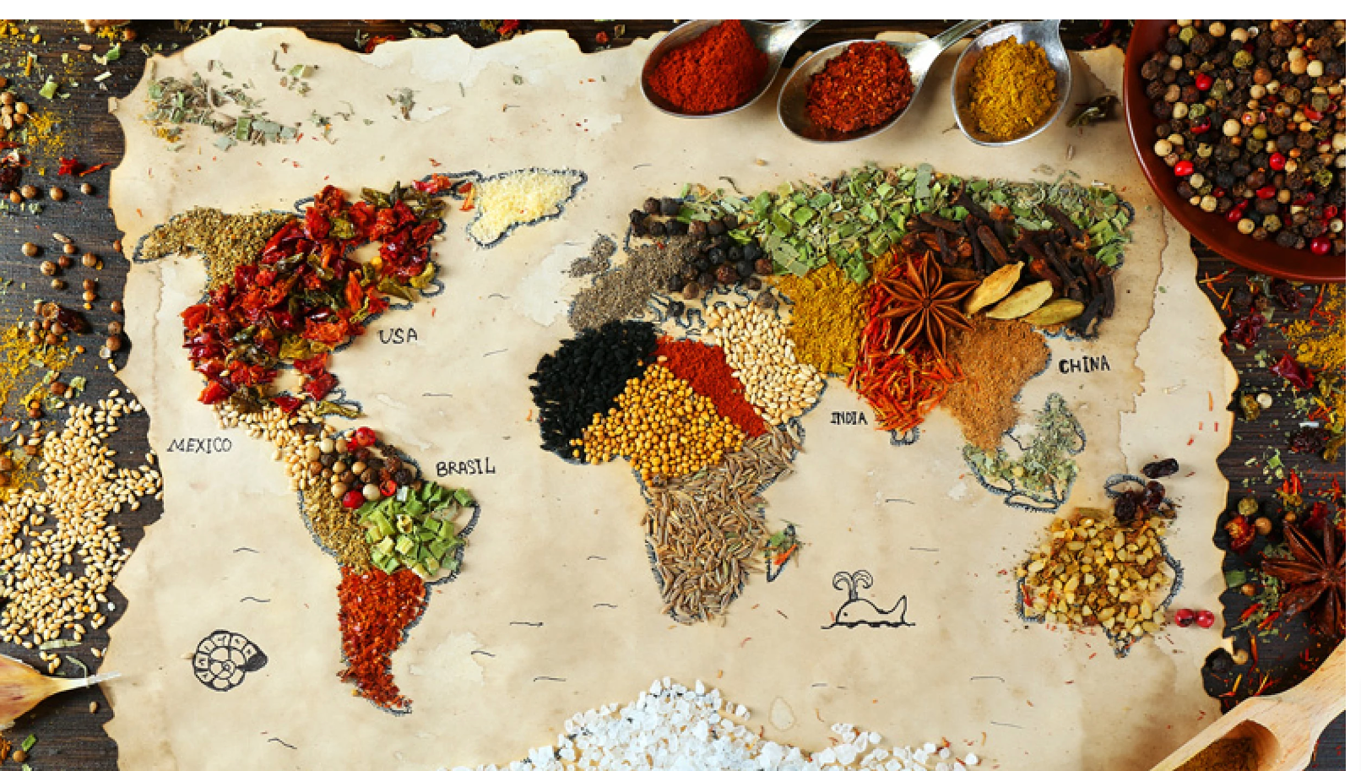
Multicultural Menu GitHubLink

Slide 2
COMP 170 – Final Project Presentation
Team Name: Team 3
Team Members:
Alberta Ayitey- Database Collection
Jeremiah Lateef- Program Structure
Shwetha Vaidyanathan- Content/Design

Slide 3
Final Project Overall Idea
Name of the Project: Multicultural Menu
How the Project works:
This project aims to present a personalized menu with dishes from Asia, Africa, the Caribbean, and Europe. The user will interact with the program by answering questions to understand their choice of region, dietary preference, and allergies, if any. The program will then provide an itemized list of menu items. The program was made to celebrate the diversity of food across the world and provide knowledge on various dishes.

Slide 4
Overall Organization
Class/program structure-
There is one main java file, along with other text files and a JSON File.
What do they do-
The JSON File has the arrays of all the menu items grouped based on the region, dietary preference, and allergies. The main java file will extract the content from this file. There are five methods in the main program.
Any Project text files and how they’re used-
There are four text files which contain content for the various questions, and statements. We created a Github repository, and hosted all our files there, this made editing and working on the file much easier.

Slide 5
Project Testing
How did you test your Project?
We tested the project by ourselves, and then got feedback from family and friends, to gauge if the various questions resonated with them.
What kinds of tests did you run?
The very first test we ran after writing out the methods was to prepare for the contingencies if the user does not provide a response. The second test we did was to ensure that the user only picks among the predefined values.
Who was responsible for what aspects of Project testing?

Slide 6
Learning Beyond Class
We learnt to use JSON, especially in terms of adding the data there, and extracting it to the main Java program. We used JSON-simple library to decode all the data from the JSON Array.
This was very difficult to work out, when Dr. Yacobellis sent us a link which gave Jeremiah the means to complete the code by linking it to the array. We also became better at understanding and collecting data from various resources. Since our project has a strong inter-cultural element, we were able to learn more about each other's cultures and cuisines.
We also learnt how to use the ternary operator in place of an if/else statement.

Slide 7
Biggest Challenges
The first challenge was choosing the database we could use to store our files. We focused on access and readability. We eventually decided to use JSON because Jeremiah had a prior experience in JavaScript and how to structure a JSON database.
The biggest challenge was decoding and extracting the data from the JSON array. We tried to use Stream API at first because that was the first option, we saw on YouTube, but it was too complicated to learn within a short time. After inquiring from Prof. Yacobellis, the JSON-simple library was recommended to us. We tried it out and after several attempts, we were able to decode the menus from the file.
When we started gathering data, we had to learn to collate, and format the data respecting the culture it has emerged from. As recipes can be changed based on preference, we decided to stick to the traditional mode of the recipe.

Slide 8
Project Demo
Multicultural Menu allows users to explore various dishes from Europe, Asia, Africa, and Caribbean. Users will be able to get a personalized list of dishes. The project has the following functionalities-
Menu Exploration
Information on the dishes

Slide 9
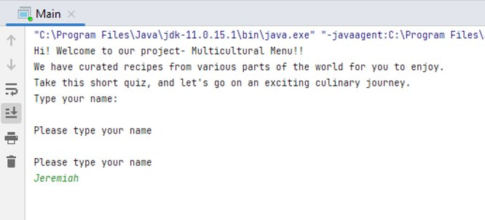
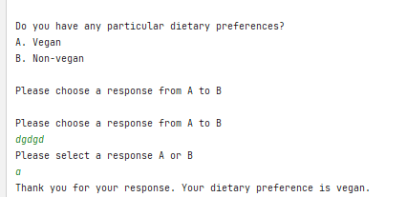
We ensured that the user provide a feedback before we proceed, and the program prompts the user until they provide a proper response.

Slide 10
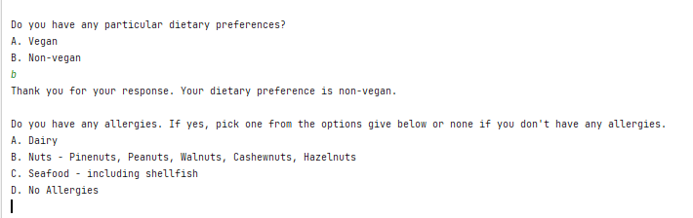
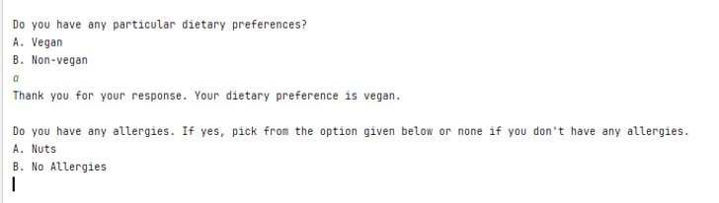
The options for the questions are also modified based on the user's dietary preference. Non-vegan has four options; vegan has two options.

Slide 11
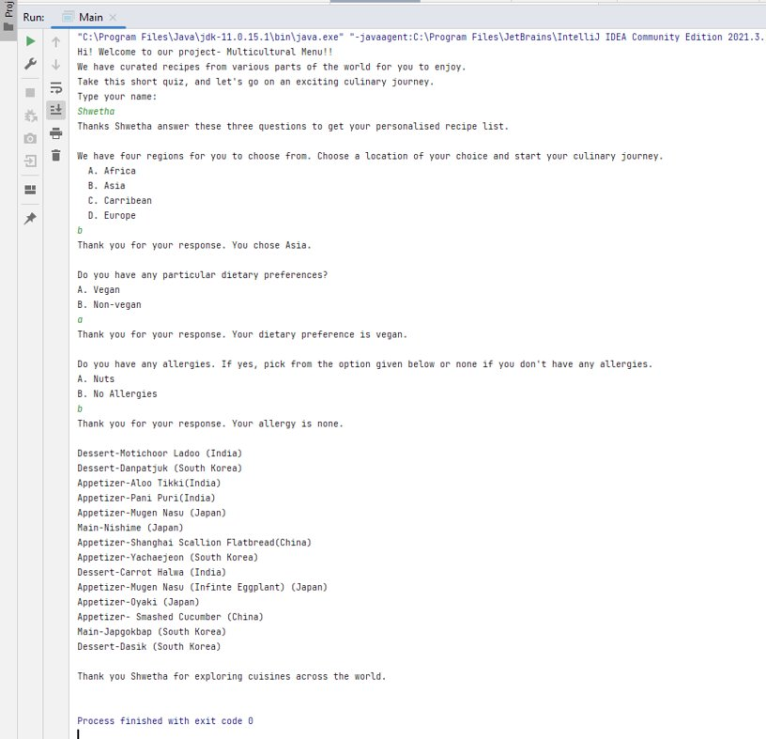
A snapshot of the program along with the results generated.

Slide 12
Thank You

